Slide 1
Employee Data Analysis using Excel
STUDENT NAME: keerthika. M
REGISTER NO: 312214726,FFCC22924D88DA3B0AF46D20C95A0F1E
DEPARTMENT: B. Com (Accounting & finance)
COLLEGE: Sri Kanyaka Parameswari arts and science college for women

Slide 2
PROJECT TITLE
Employee Salary Analysis using Excel

Slide 3


AGENDA
Problem Statement
Project Overview
End Users
Our Solution and Proposition
Dataset Description
Modelling Approach
Results and Discussion
Conclusion
3/21/2024 Annual Review

Slide 4

PROBLEM STATEMENT
Organizations conduct salary analysis to ensure that employees are paid fairly and competitively, and to help motivate and retain employees: *Fairness: Salary analysis helps ensure that employees are paid fairly and equitably, both internally and compared to external benchmarks. *Competitiveness: Salary analysis helps ensure that employees are paid competitively in the job market. *Motivation: Salary analysis helps ensure that employees are motivated and that compensation is a crucial driver of performance. *Compliance: Salary analysis helps ensure that compensation complies with legal regulations. *Alignment with business goals: Salary analysis helps ensure that compensation aligns with business goals. *Retention: Salary analysis helps attract and retain talent.

Slide 5

PROJECT OVERVIEW
*Purpose:* - Evaluate pay structure and compensation practices - Ensure competitiveness, fairness, and alignment with industry standards - Attract and retain top talent - Avoid legal issues related to pay discrimination *Factors to Consider:* - Internal factors: - Performance appraisals - Job descriptions - Salary structures - Geographical location - External factors: - Market conditions - Industry trends - Market surveys - Industry benchmarks

Slide 6

WHO ARE THE END USERS?
* HR professionals * Managers * Decision makers * Payroll department * HR department

Slide 7

OUR SOLUTION AND ITS VALUE PROPOSITION
Ensuring fair and transparent salaries can attract and keep top talent, boosting job satisfaction and motivation. A well-structured pay system helps retain skilled employees, reducing turnover costs. Competitive salaries enhance engagement and productivity, recognizing employees’ efforts and fostering a positive work environment. Fair compensation not only benefits employees but also adds value to the company by improving retention rates and overall productivity.

Slide 8
Dataset Description
When describing a dataset related to employee salaries, it typically includes information such as the employee’s job title, years of experience, level of education, department, performance ratings, and of course, the corresponding salary or compensation. This dataset helps analyze factors influencing salaries within an organization, such as the impact of education, experience, and job role on compensation levels. By studying this data, companies can make informed decisions on salary structures, promotions, and overall compensation strategies to ensure fair and competitive pay for their employees.

Slide 9

THE "WOW" IN OUR SOLUTION
Incorporate interactive dashboards with colorful charts and graphs in Excel to showcase key salary metrics, making the data visually appealing and easy to interpret. Add dynamic features like drop-down menus for user interaction, enhancing the overall presentation and creating a “wow” factor in your employee salary analysis.
3/21/2024 Annual Review
9

Slide 10
MODELLING
To model employee salary in Excel, you can create a spreadsheet with columns for employee details such as job title, years of experience, education level, department, performance ratings, and salary. Utilize Excel functions like VLOOKUP, INDEX-MATCH, and IF statements to calculate salaries based on these factors. You can also use formulas to determine bonuses, raises, or other compensation adjustments. By setting up this model in Excel, you can analyze how different variables impact employee salaries and make informed decisions regarding compensation within your organization.
10

Slide 11
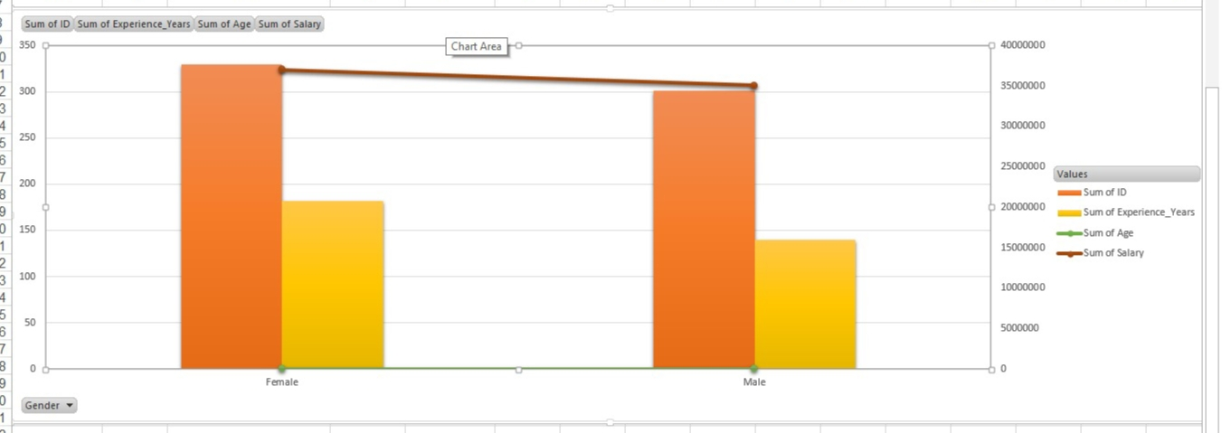
RESULTS
11

Slide 12
conclusion
By incorporating various factors like job title, experience, and performance into Excel calculations, you can create a comprehensive model for employee salaries. Using functions like VLOOKUP and formulas for bonuses and raises enables detailed analysis, facilitating informed decisions on compensation within the organization. This Excel tool provides a structured approach to managing and understanding employee pay effectively.

